Slide 1
Dynamically Adaptable Software Is All About Modeling Contextual Variability And Avoiding Failures
PAPER #6
CRITIQUE
SWATI SINGH (CLASS ID: 38)
SAMHITHA (CLASS ID: 45)
ZEENAT TARIQ (CLASS ID: 42)
KHUSHAL SHAH (CLASS ID: 34)

Slide 2

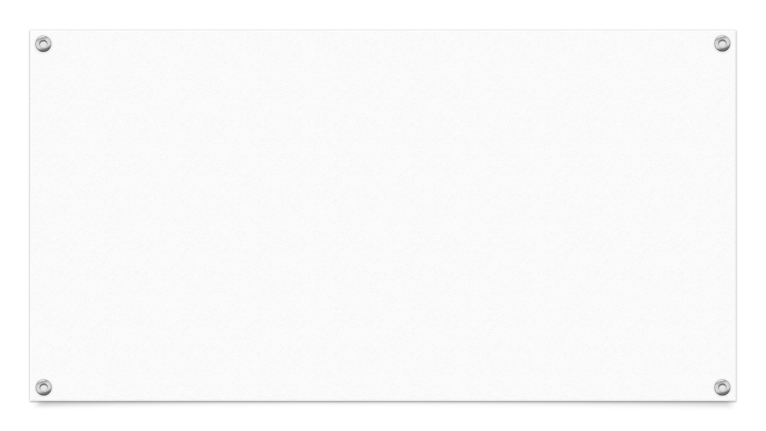


ABOUT
DAS can be considered a dynamic software product line (DSPL) in which variabilities are bound at runtime. So, practitioners have used DSPL engineering to support DAS development. This has helped DAS developers cope with contextual variability and the large number of configurations.

Slide 3

OVERVIEW
Adaptable software is able to handle autonomous decision-making, according to varying conditions. Recent development approaches such as Dynamic Software Product Lines (DSPLs) attempt to face the challenges.
Variability modeling
Contextual-Variability Modeling Techniques
The Best Way to Model
Model-Checking Adaptive Behavior
Tips for Working with Dynamically Adaptable Software

Slide 4
General criticism of the study design
Positive criticism:
Appreciable research done on comparison of CFM and eCFM.
Lot of time and effort was spent in conducting survey.
Provided tips for Software Engineers who work on DAS.
Negative criticism:
It doesn’t solve all the modelling issues.
Only five behavioral properties were considered while evaluating CFM.
Survey would need different participant profiles and the population needs to be more.

Slide 5
Positive Constraints
Lets Software engineers to model constraints among context features.
Group concepts lets Engineers organize context features into categories.
Faults are identified in the early stage.
It helps Engineers handle diverse contexts.
It helps in avoiding adaptation failures during DAS execution.
Lets the Engineers to define context groups according to the context source.

Slide 6
Negative Constraints
Incomplete information on the criteria used in evaluation of CFM.
Main VMTs were identified based on DSPL Literature based on 12 criteria is mentioned in the journal. No information regarding how the criteria was defined.
Since experiments were used in identifying CFM>TGMC, the data might not be accurate completely.
CFM has limited expressiveness – doesn’t allow to define constraints among contexts.
As the number of properties to verify increase in model checking, the time taken to verify them increases.

Slide 7
Questions Topic
Model Techniques
Dynamically adaptable Software (DAS)
Dynamic Software Product Line (DSPL)
Variability Modeling Technique (VMT) for DAS
Context Aware Feature Modeling
Tropos Goal Model (TGMC)
Groups Specification
Advantages and Disadvantages
Real World Scenario

Slide 8
Model Techniques
Why the practitioners have used DSPL Engineering to support DAS development?
What were the positive aspects/results after using DSPL?

Slide 9
Contd..
What were the Models and criteria's on which VMTs were calculated?
TGMC and CFM are similar regarding the dynamic elements they can model. On what parameters CFM was found to be more effective than TGMC?

Slide 10
Groups Specification
What were the limitations of CFM that eCFM was introduced?
On what basis/relationships the Context features specification were made?

Slide 11
Contd..
What will be the advantage and disadvantage of specifying group other than OR/XOR ?
Can you give one Example (not included in the paper)in which the dynamic Model is beneficial?

Slide 12
THANK YOU !!

